Slide 1
Regional Economic and Potential Tourism Impacts in Rhode Island of NOS4A2 and The Gilded Age
Prepared for:
Newport County Development Council
Presented to:
State of Rhode Island
House Committee on Oversight, Subcommittee on Tourism, Arts, and Recreation
Presented by:
Leslie Genova, Principal
Joseph Chang, Associate
Industrial Economics, Incorporated

Slide 2
Overview
Key Findings
Rhode Island Motion Picture Tax Credit
Scope of Analysis
NOS4A2 Expenditures
Results – Regional Economic Impacts of NOS4A2
Brief comparison to the Rhode Island DOR Report
Potential Tourism Benefits of The Gilded Age

Slide 3
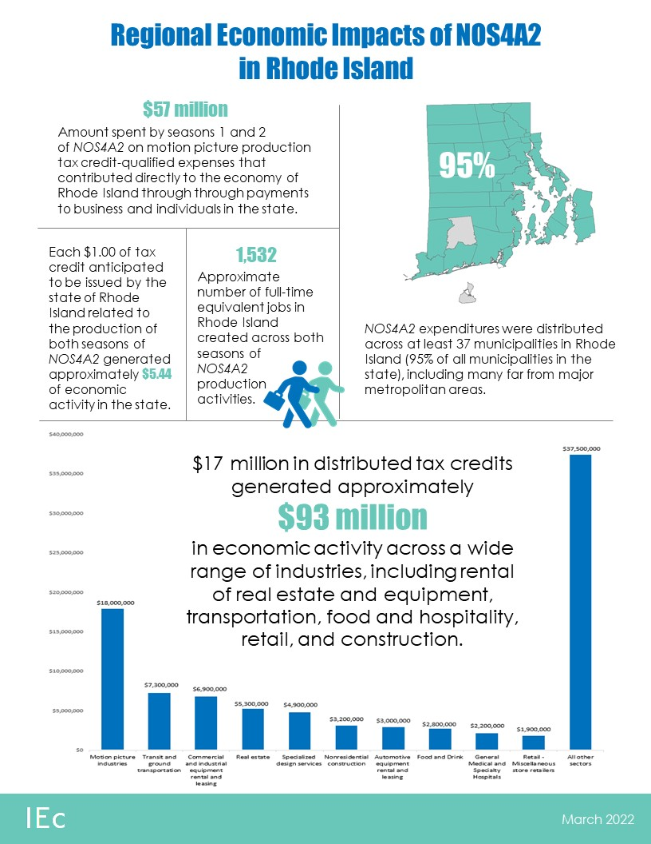

Source: IMDB

Slide 4
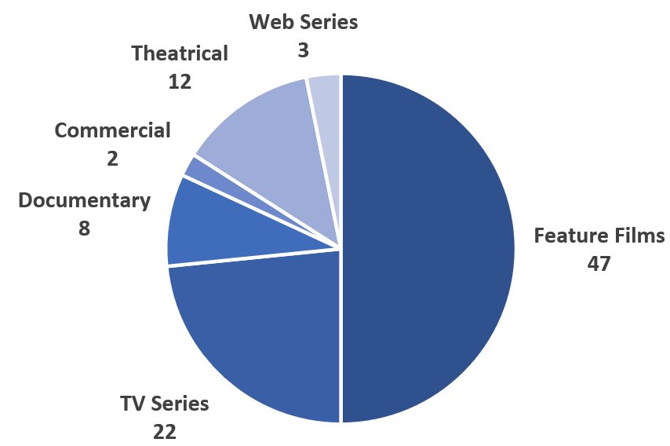
Rhode Island Motion Picture Tax Credit
Between 2005 and 2020, 94 film and television productions received tax credits in Rhode Island
Qualified production expenses ranged from $110,000 to $38 million
Received tax credits ranged from $27,000 to $9.5 million

Slide 5
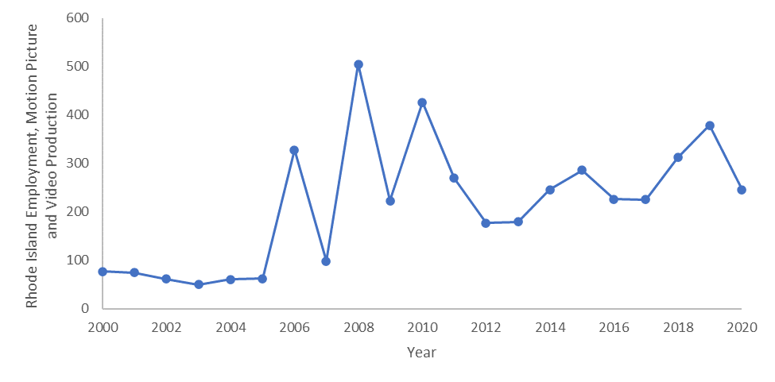
Rhode Island Motion Picture Tax Credit
The Motion Picture and Video Production industry (NAICS 51211) in Rhode Island
  averaged 64 employees between 2000 and 2005
  averaged 275 employees 2006 to 2020
  430 percent increase in direct industry employment during the period following tax credit implementation
Source: BLS Annual Data, 2000-2020

Slide 6
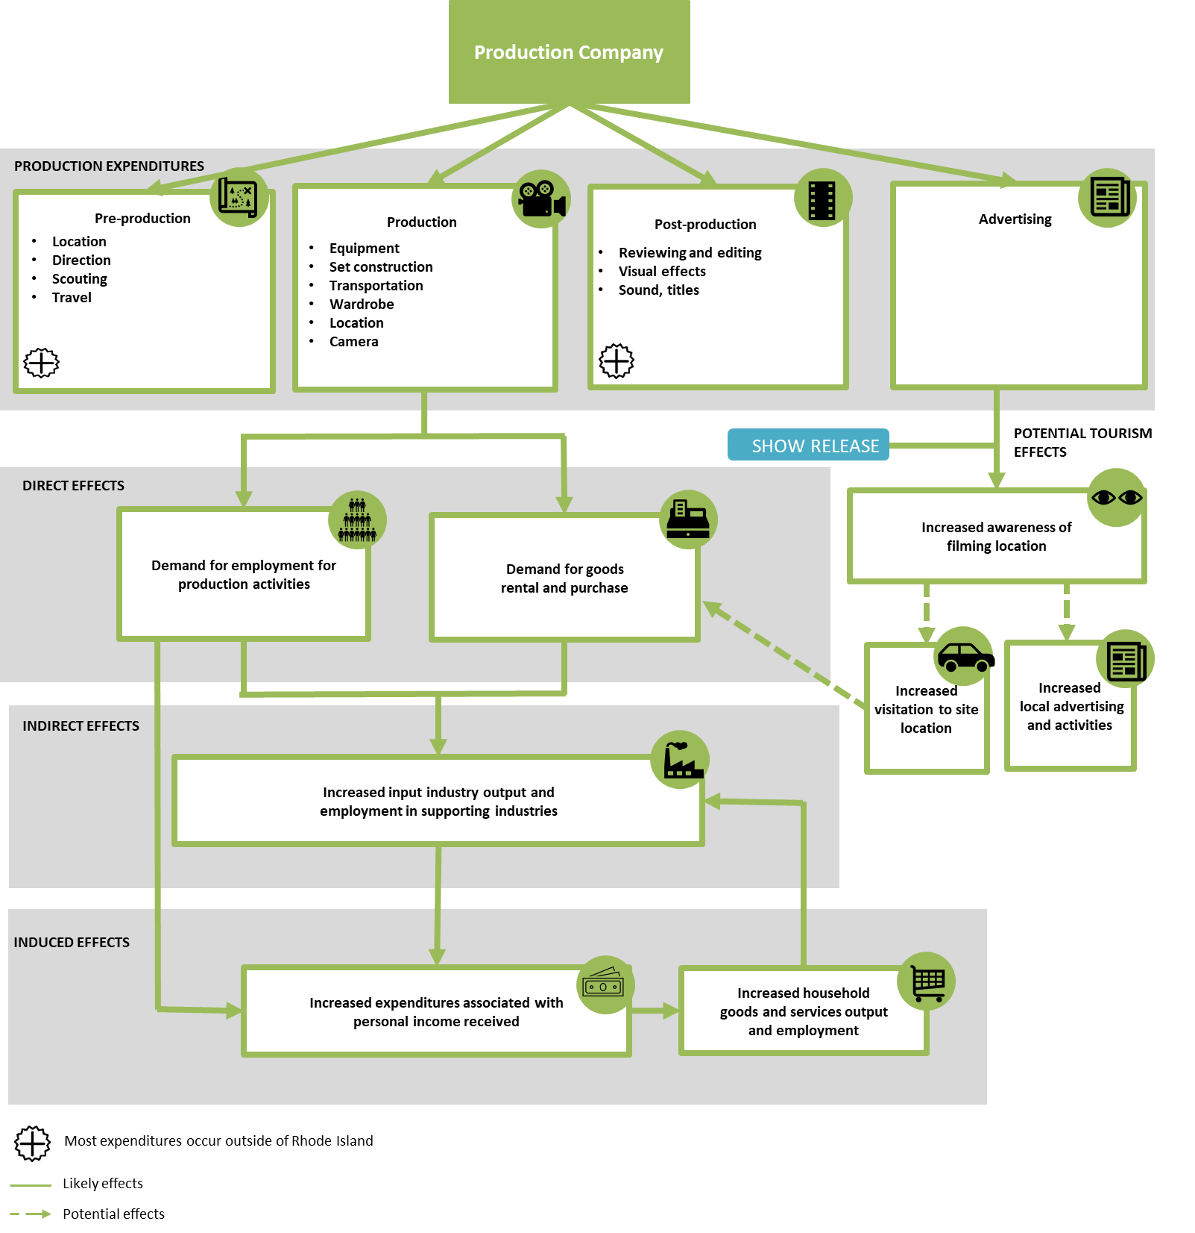
Overview of our Analysis
Potential Tourism Benefits – The Gilded Age
Regional Economic Impacts – NOS4A2

Slide 7
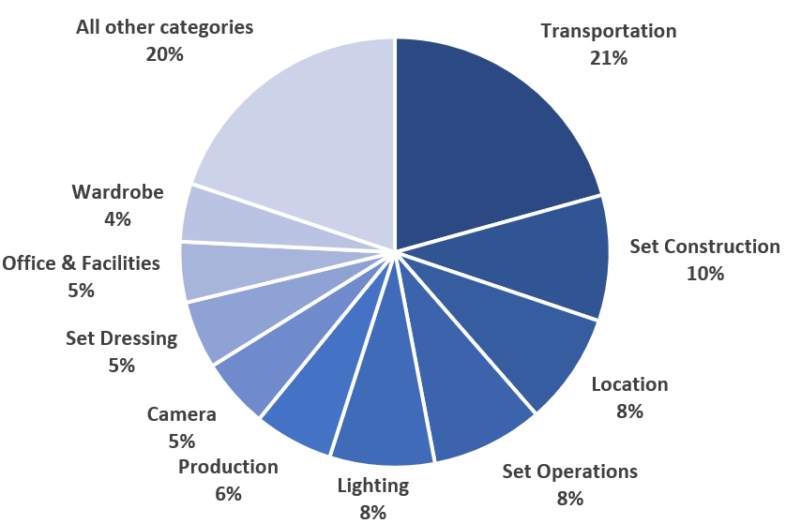
NOS4A2 Expenditures in Rhode Island (Seasons 1 and 2)
Total:
$57 million in expenditures,
excluding above-the-line expenses

Slide 8
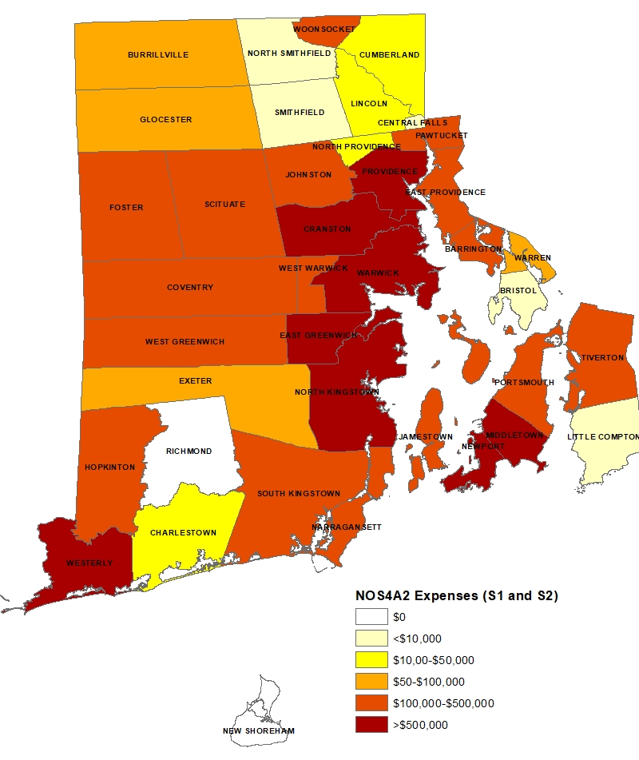
Distribution of NOS4A2 Expenditures
Expenditures in 95% of communities
Utilized over 650 vendors in the state
Source: AMC data. Note: Location data was not available for all expenditures

Slide 9
Regional Economic Impacts of NOS4A2 Expenditures in Rhode Island
Sector | Employment (FTE) | Labor Income | Value Added | Output
Motion picture and video industries | 337 | $16,000,000 | $16,000,000 | $18,000,000
Transit and ground passenger transportation | 520 | $7,000,000 | $7,000,000 | $7,300,000
Commercial and industrial machinery and equipment rental and leasing | 28 | $1,150,000 | $3,800,000 | $6,900,000
Other real estate | 39 | $550,000 | $1,840,000 | $5,300,000
Specialized design services | 92 | $4,900,000 | $4,900,000 | $4,900,000
Construction of other new nonresidential structures | 62 | $2,600,000 | $2,700,000 | $3,200,000
Automotive equipment rental and leasing | 19 | $520,000 | $1,700,000 | $3,000,000
All other food and drinking places | 47 | $1,100,000 | $1,500,000 | $2,800,000
Hospitals | 11 | $900,000 | $1,200,000 | $2,200,000
Retail – miscellaneous store retailers | 60 | $630,000 | $780,000 | $1,900,000
All Other Sectors | 319 | $14,600,000 | $23,600,000 | $37,500,000
Total Effect | 1,532 | $50,000,000 | $65,000,000 | $93,000,000
Source: AMC data, IMPLAN and IEc analysis.

Slide 10
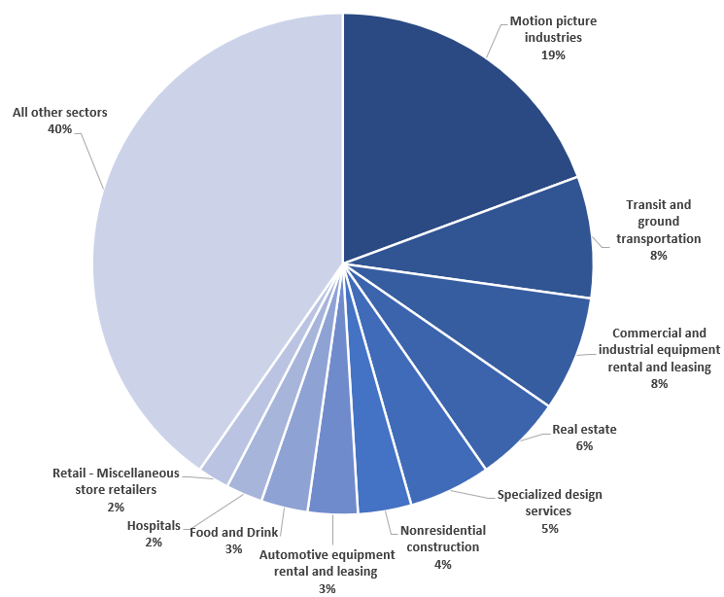
Regional Economic Impacts of NOS4A2 Expenditures in Rhode Island
Sources: AMC data and IEc analysis.

Slide 11
Regional Economic Impacts of NOS4A2 Expenditures in Rhode Island
The production of NOS4A2 is estimated to receive $17 million in tax credits (30% of qualified expenditures).
$17 million in tax credit generated $93 million in economic activity in the State across a wide range of industries.
Each $1.00 of tax credit issued by the State of Rhode Island related to the production of NOS4A2 generated approximately $5.44 of economic activity in the state.
The production created demand for approximately 1,532 full-time equivalent jobs in Rhode Island between 2018 and 2020.
Sources: AMC data and IEc analysis.

Slide 12
Comparison to 2021 Rhode Island DOR Report
RI DOR evaluates how the taxes paid to Rhode Island associated with film production spending compared to the state taxes foregone by Rhode Island in granting the tax credit
Considered 11 productions filmed between 2016 and 2018
Relied on an incomplete set of available tax data from the Rhode Island Department of Taxation
Our analysis differs from this DOR report in several respects, so it is difficult to make apples-to-apples comparisons between them

Slide 13
Estimates of Film Tourism and Example of The Gilded Age
Literature and widespread anecdotal evidence suggest that film and TV productions have the potential to increase local tourism.
We reviewed 39 academic and industry studies of film tourism:
  Studies provide estimates of film tourism for 38 film and TV productions, which range widely
  Studies use 3 approaches: case studies (visitor surveys), regional and national studies (trend studies), estimates of advertising exposure value
  Studies identify production characteristics that increase likelihood of film tourism

Slide 14
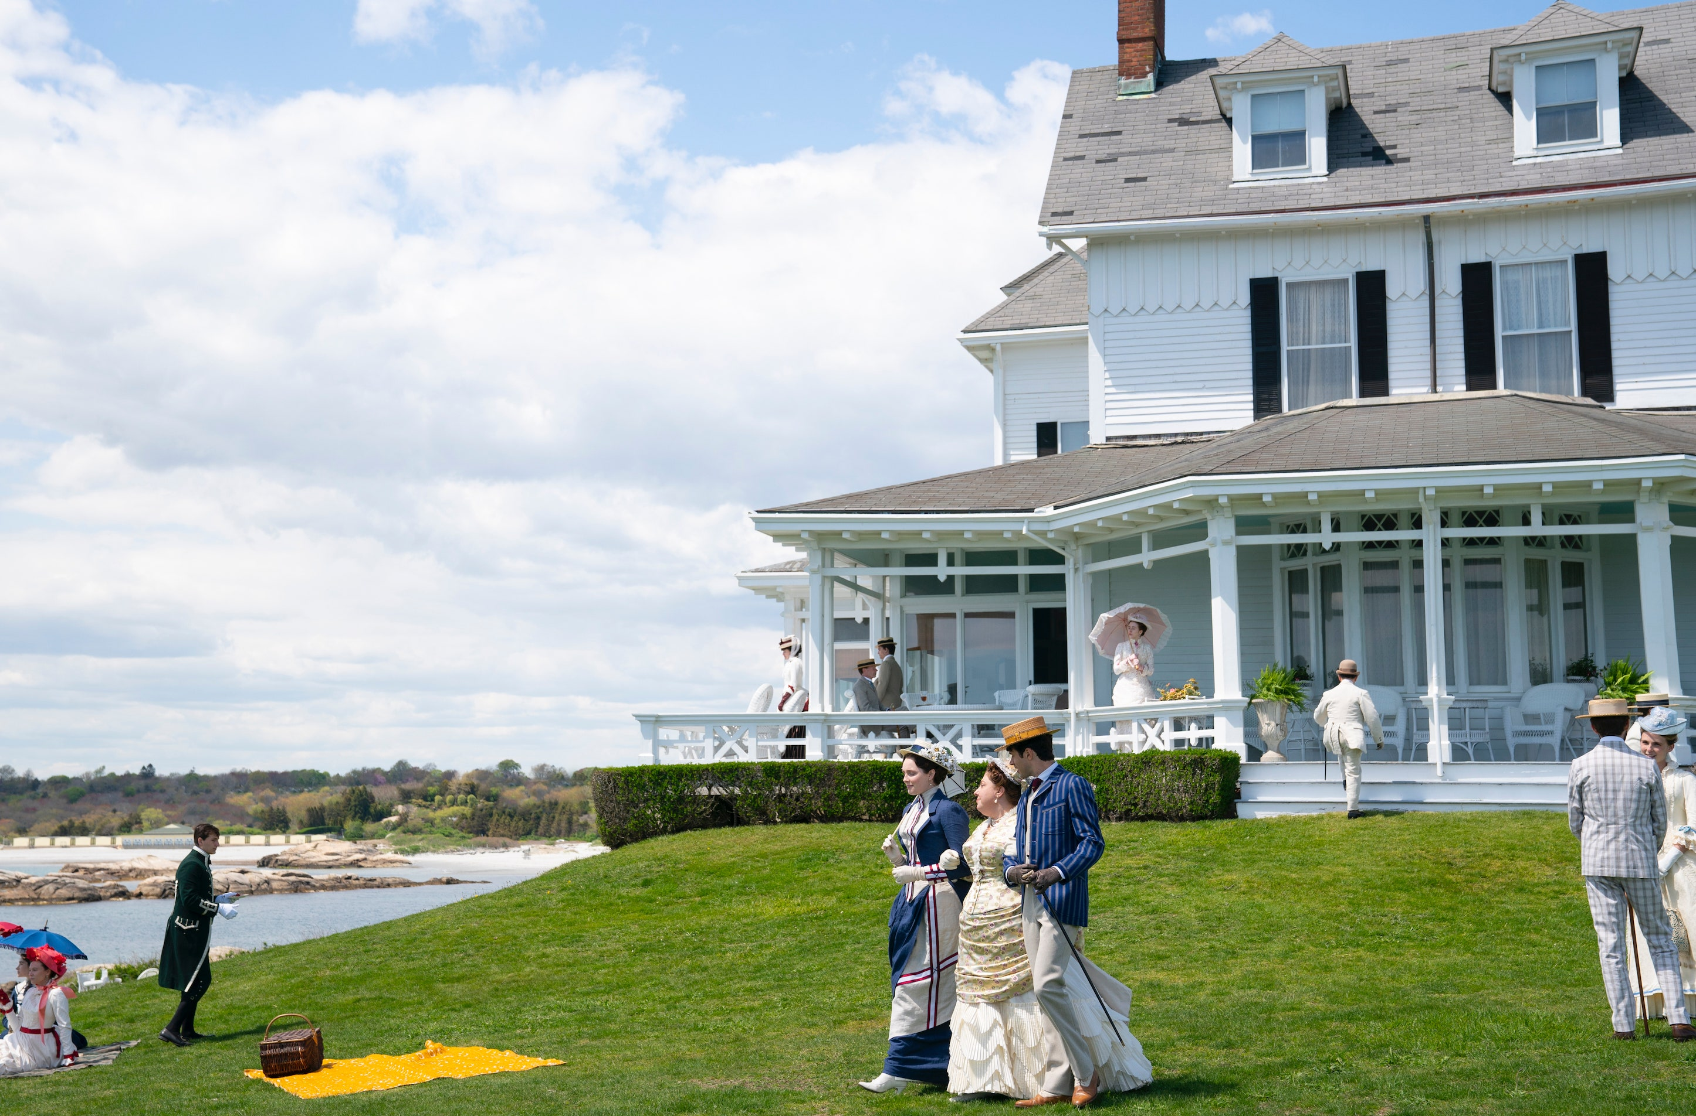
Potential Tourism Benefits of The Gilded Age
The Gilded Age possesses characteristics that could increase the likelihood for it to attract film tourists to Rhode Island
  Potential for strong iconic identification with Newport and the Newport Mansions
  Potential for popularity and longevity of the production
  Production setting as a period drama with heritage buildings
  Support from a major production company and Rhode Island-based partners*
Source: Architectural Digest
*Rhode Island partners include the Rhode Island Film & TV Office, the Rhode Island Commerce Corporation, Preservation Society of Newport, Discover Newport, Newport Chamber of Commerce, Newport County Development Council, and Airport Corporation

Slide 15
Potential Tourism Benefits of The Gilded Age
  It is premature to estimate specific impacts of the Gilded Age on tourism, but early signs are promising.
  The Gilded Age has been “green-lit” for a second season after only a few episodes of its inaugural season, it has continued to increase in audience viewership across its first season, and it ranked among the top ten in-demand series at points during this period (Parrot Analytics, 2022).
  A preliminary estimate of exposure value suggests that each distinct exposure of Newport in an episode could be valued at $45,000 in advertising value.
metric | Hypothetical exposure value
Distinct Views / Minutes of screen timeª | 1
Average audience per episode^{b} | 3 million
Cost per advertisement^{c} | $260,000
Value per impression^{c} | $0.015
Exposure value per episode | $45,000
a Defined as discrete scenes or shots where a clearly identifiable Rhode Island location is present. Initial estimate is based on the number of exterior shots of Rhode Island locations and scenes filmed in the interior of the Newport Mansions. ^{b} Initial estimates available for episodes 1-4. We do not differentiate between an audience member who views the show during its initial airing versus an audience who watches the show via a streaming platform (or similar) after it’s initial airing date: https://deadline.com/2022/02/the-gilded-age-ratings-viewership-grows-15-week-2-surpasses-white-lotus-1234924598/ Source: HR&A, 2013.

Slide 16


Thank you!
Questions?

